Slide 1
Professional Practice of Education Assistants
Self Portrait

Slide 2

U.S. National Study (2008)
What other paraeducators say you should know about inclusive classrooms:
  Be willing to ask
    Ask questions
    Read books
    Collaborate and communicate
    Learn strategies to help children

Slide 3
U.S. National Study (2008)
What other paraeducators say you should know about inclusive classrooms:
  Be flexible
    Be prepared to be busy
    Be prepared to work with some people who may not know exactly what to do with you

Slide 4
U.S. National Study (2008)
Remember:
  Each child learns differently. Know each student’s capabilities.
  Each child has talents or strengths that you can help to surface in the classroom to help build their self-esteem.
  Each student learns at a different rate.
  There is nothing better than seeing kids succeed!

Slide 5
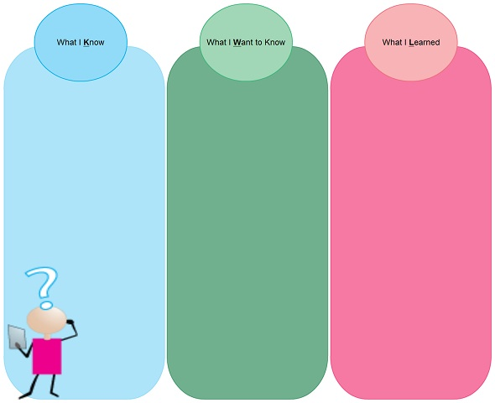
Activity: KWL
Complete chart on own
Put points up on chart paper
If your point is already up, put a check mark beside it

Slide 6
A Competent Education Assistant
 Heart = beliefs, attitudes, personal attributes
 Hand = skills/practices
☺ Head = knowledge

Slide 7
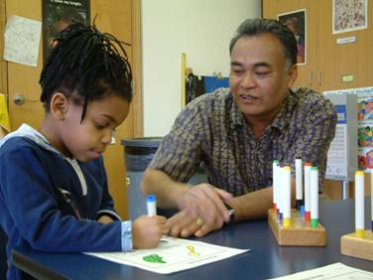

Professional Practice of Education Assistants

Slide 8
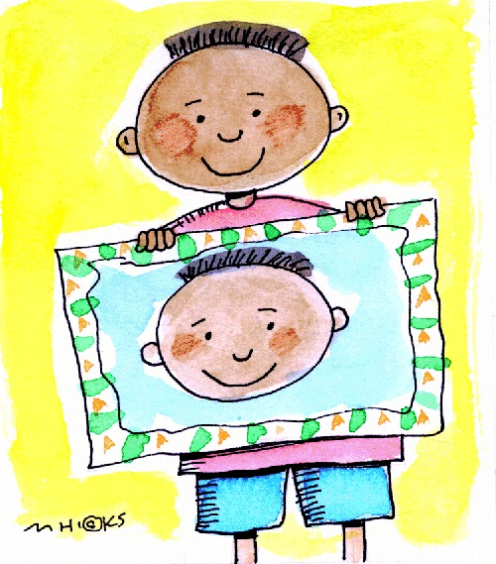
Activity: Me as a Developing Education Assistant
Create an image of your self that incorporates your knowledge, personal attributes/strengths and skills.
Somewhere in your portrait insert 2-3 areas in which you need to develop.

Slide 9
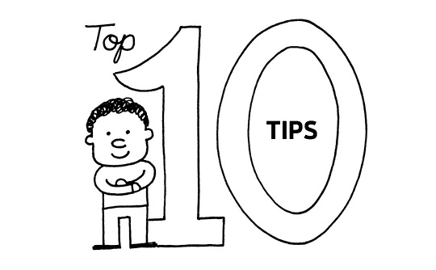
Ten Tips for Paraeducators
What would the top ten tips be?
Review Project Participate suggestions - what do you think?

Slide 10
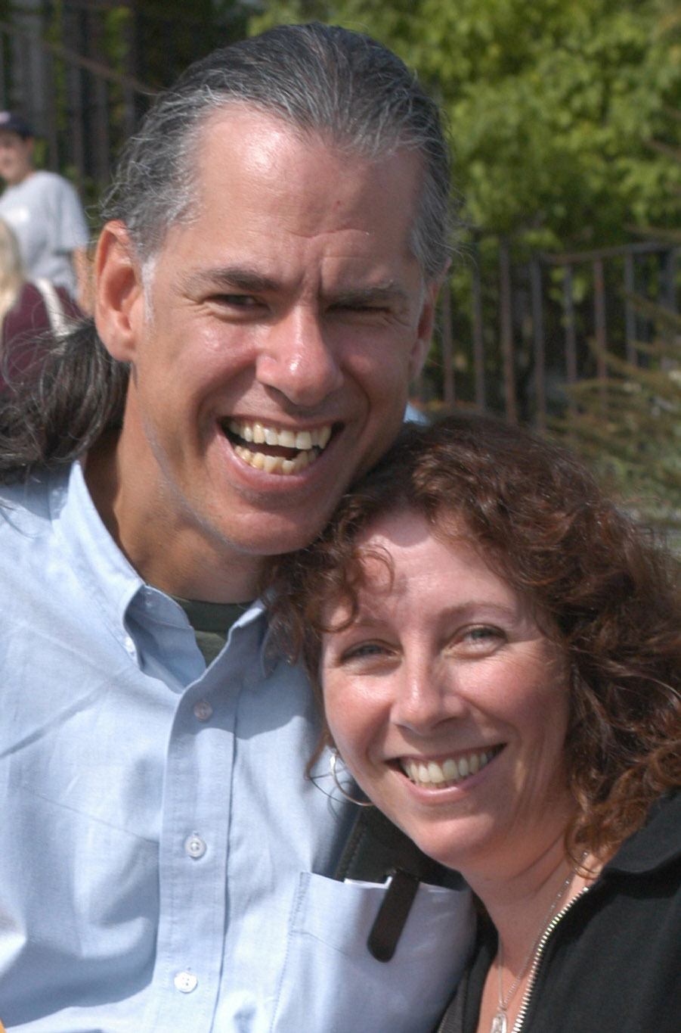
In the words of Norman Kunc
A credo of support

